Slide 1

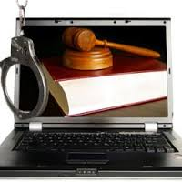
CYBERCRIME CASES- SAFEGUARDS

Slide 2
A PRESENTATION
BY
PAVAN DUGGAL
ADVOCATE, SUPREME COURT OF INDIA
PRESIDENT, CYBERLAWS.NET
HEAD, PAVAN DUGGAL ASSOCIATES

Slide 3

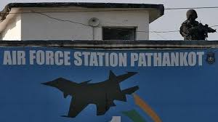
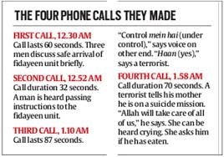
PATHANKOT ATTACKS – CYBER WAR AGAINST INDIA

Slide 4
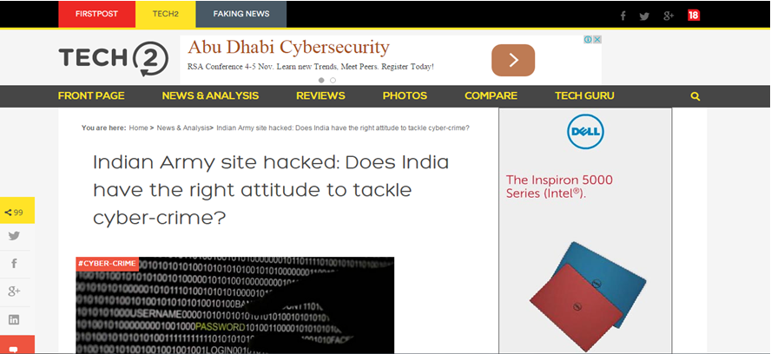
INDIAN ARMY WEBSITE HACKING

Slide 5
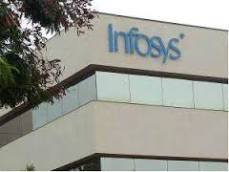

INFOSYS EMPLOYEES SALARY ACCOUNTS HACKING

Slide 6
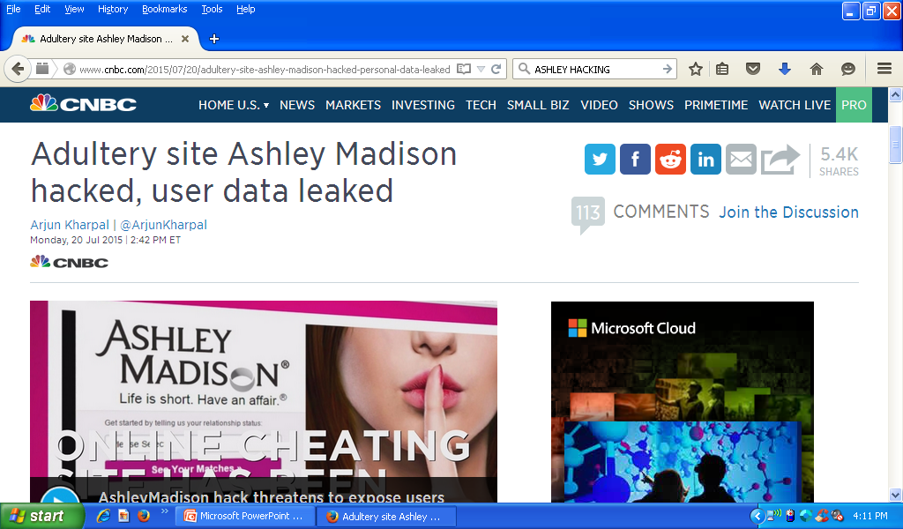
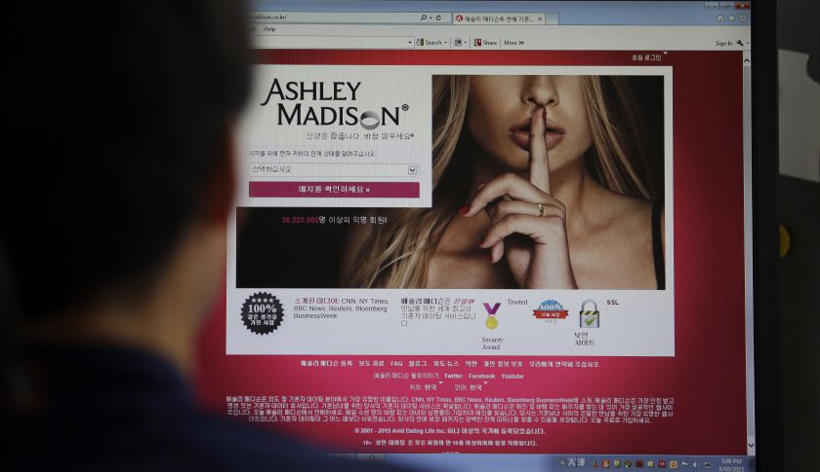
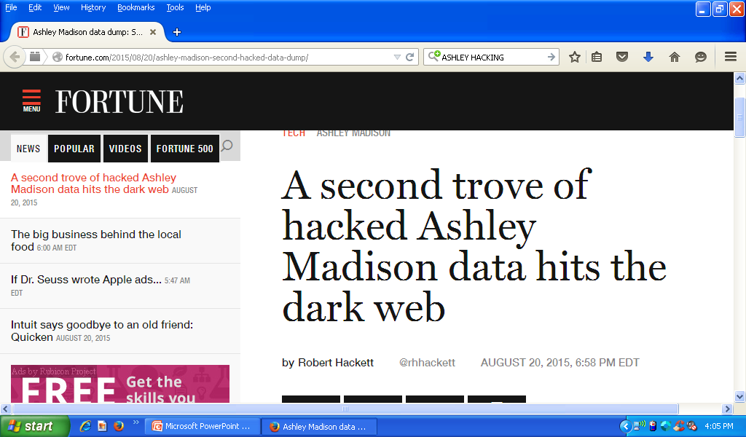
ASHLEY MADISON WEBSITE HACKING

Slide 7
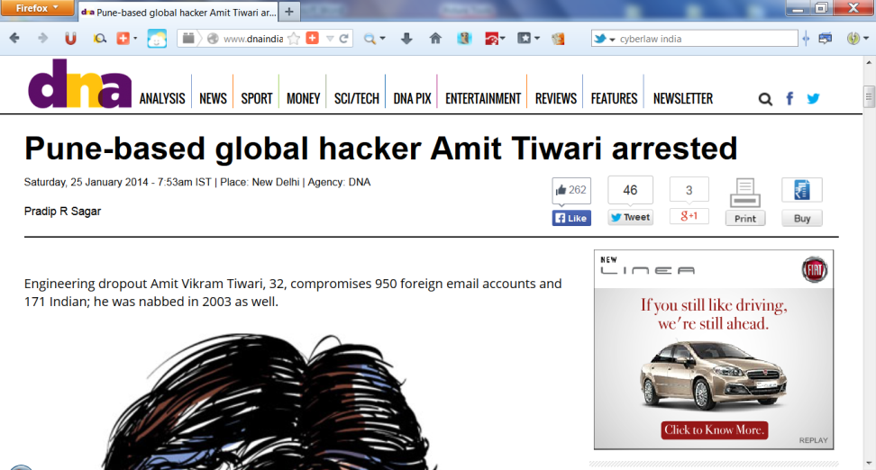

CYBERCRIME AS A SERVICE

Slide 8


BANGALORE CYBER WAR
Facebook and Twitter were used to disseminate hateful content leading to the Bangalore Cyber terror attacks

Slide 9
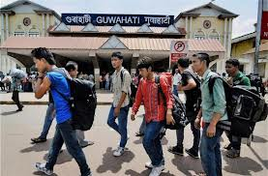
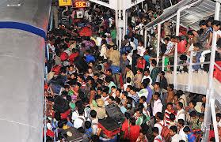
15TH AUGUST, 2012- BANGALORE MASS MIGRATIONS

Slide 10
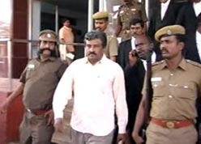
DR. L. PRAKASH- INDIA’S FIRST LIFE TIMER CYBER CRIMINAL
FEBRUARY 7, 2008-
'Sex doctor' gets life in cyber-porn case
CNN-IBN

Slide 11
IMPORTANT CASES
Data shared with competition case
True Caller and CEO phone number compromise case
Calls for fake interviews on social media case
Gurgaon call centre spy camera girl termination case

Slide 12

GURUJI.COM SEARCH ENGINE – CRIMINAL ACTION

Slide 13

NIRMALJIT SINGH NARULA
Vs. INDIJOBS AT HUBPAGES.COM & ORS

Slide 14
RECENT HACKING
EMAIL ACCOUNTS OF SENSITIVE INSITTUTIONS AND DEPARTMENTS OFFICIALS HACKED
ACCOUNTS BELONGED TO NATIONAL DEFENCE ACADEMY & DRDO OFFICIALS

Slide 15
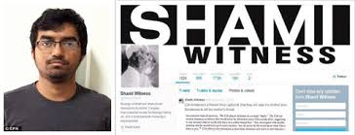

SHAMI TWITTER HANDLE

Slide 16
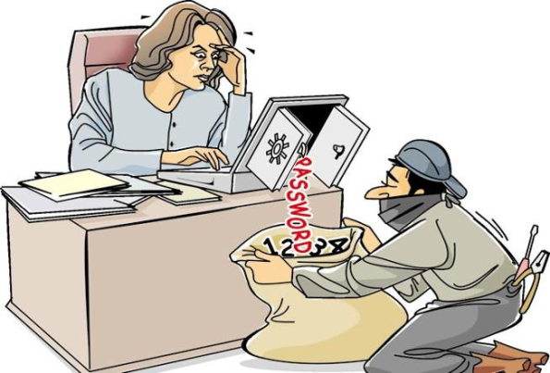


VIRII, VULNERABILITIES ALL AROUND- STUXNET, BLADABINDI, HEARTBLEED

Slide 17


ONLINE FAKE RECRUITMENT SCAMS

Slide 18



CLOUD COMPUTING &CYBERLAW

Slide 19



BRING YOUR OWN DEVICE (BYOD)

Slide 20

BIG DATA

Slide 21



WHATSAPP – THE NEW MEDIUM OF COMMUNICATION

Slide 22
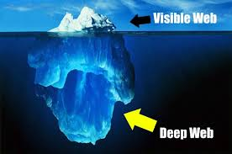

DARK WEB & CYBERLAW
Dark web is a new reality. However, the law-enforcement agencies and legal regimes are thoroughly incapable of dealing with dark web.
The layers of anonymity that the onion browser provides ensures that legal frames are today thoroughly incapable of dealing with the dark web and connected legal, policy and regulatory issues.

Slide 23
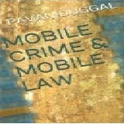
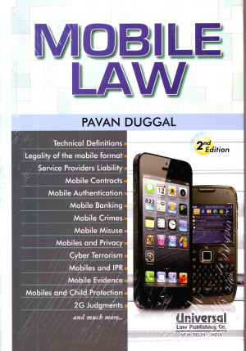
MOBILE CRIMES
There are various kinds of mobile crimes that have emerged across the world. In fact, given the increase in adoption of mobiles, communication devices, mobile platforms, and the mobile paradigms by vast sections of populations across the world, mobile criminals have suddenly found mobiles platforms as a very innovative and fertile space for perpetuating their criminal activities.

Slide 24
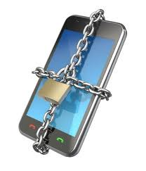
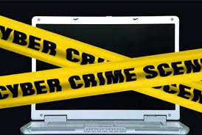


CYBERCRIME

Slide 25

CASES
Baazee.com case
Famous Bank NSP case-2003
Umashankar Case

Slide 26
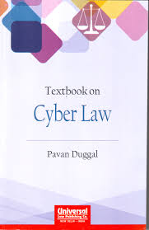
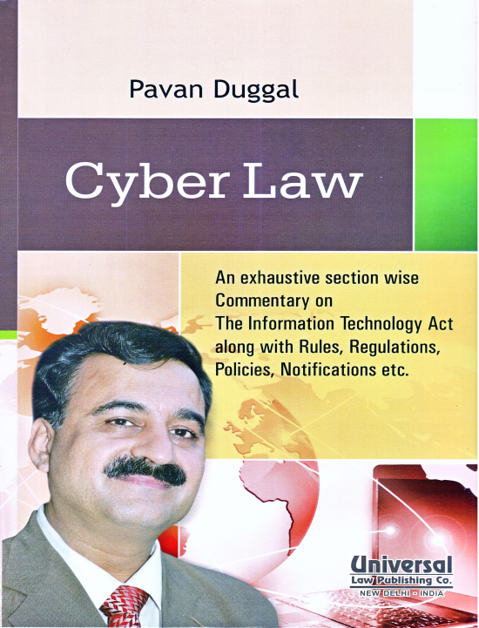
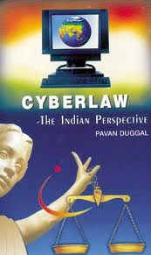
CYBERLAW IN INDIA

Slide 27



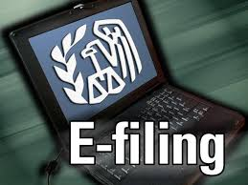

THE IT ACT, 2000 – INDIA’S FIRST CYBERLAW

Slide 28
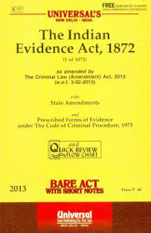


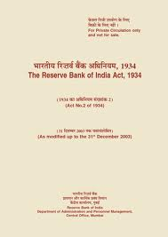
FOUR DIFERENT ACTS AS AMENDED BY IT ACT, 2000

Slide 29

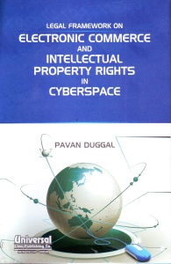
ELECTRONIC CONTRACT

Slide 30


Slide 31


INTERMEDIARIES & CYBERLAW

Slide 32

INTERMEDIARIES AND DUE DILIGENCE UNDER THE IT ACT, 2000
Intermediaries are required to do due diligence under the terms of the amended Information Technology Act, 2000.
This due diligence must be done to ensure compliance with the relevant parameters of the amended Information Technology Act, 2000.

Slide 33

LIABILITIES OF INTERMEDIARIES AND THE INDIAN CYBERLAW
Liability of intermediaries has been specifically now provided under Section 79 of the amended Information Technology Act, 2000.
“Google v/s Vishakha” case before the Hon'ble Supreme Court of India.
The emphasis on exercise of due diligence by intermediaries is an important aspect. However, enforceability and implementation of the Information Technology Act, 2000 has always been a challenge.
Most of the companies in India comply with the Information Technology Act, 2000 in breach rather than in observance.

Slide 34
LIABILITIES OF INTERMEDIARIES AND THE INDIAN CYBERLAW
There could have exposure to legal consequences, both civil and criminal, for the company and its top management.
Civil liability-damages by way of compensation upto 5o million INR per contravention
Criminal Consequences - The top management could also be exposed to criminal consequences ranging from imprisonment of 3 years to life imprisonment and fine from 1 Lakh INR to 10 Lakhs INR.

Slide 35
SAFEGUARDS RE CYBERCRIME CASES
COMPLIANCE WITH SECTION 65B OF THE AMENDED EVIDENCE ACT
ANWAR VERSUS BASHIR – THE GUIDING LIGHT
NEED FOR LAW TO FURTHER DEVELOP AS CHALLENGES OF MOBILE EVIDENCE INCREASE

Slide 36
SAFEGUARDS RE CYBERCRIME CASES( contd)
CHALLENGES RAISED BY MOBILE APPLICATION RELATED ELECTRONIC EVIDENCE

Slide 37
SAFEGUARDS RE CYBERCRIME CASES( contd)
NEED TO ALLOW DETAILED CROSS EXAMINATION OF EVIDENCE UNDER SEC 65B OF THE EVIDENCE ACT
ADMISSIBILITY – PHASE 1
GENUINENESS- PHASE 2

Slide 38
SAFEGUARDS RE CYBERCRIME CASES( contd)
NEED FOR APPROPRIATE PRESERVATION OF ELECTRONIC EVIDENCE AS ACCORDANCE WITH IT ACT

Slide 39
SAFEGUARDS RE CYBERCRIME CASES( contd)
RESORT TO LEGAL PROVISIONS PERTAINING TO RESPONSIBILITY OF INTERMEDIARIES – FOR DATA LOGS AND RELATED ELECTRONIC LOGS

Slide 40
SAFEGUARDS RE CYBERCRIME CASES( contd)
NEED FOR HOLSITIC INTERPRETATION OF THE PROVISIONS OF LAW

Slide 41
CONCLUSION
Only in compliance, compliance and compliance `with existing law lies the way for effective convictions of cybercrime cases in the digital and mobile ecosystem.

Slide 42

A PRESENTATION
BY
PAVAN DUGGAL
ADVOCATE, SUPREME COURT OF INDIA
PRESIDENT, CYBERLAWS.NET
PRESIDENT, CYBERLAW ASIA
HEAD, PAVAN DUGGAL ASSOCIATES
pavan@pavanduggal.com
pavanduggal@yahoo.com

